Slide 1
PIP2001- Capstone Project VIVA-VOCE
PRECISION FERTILIZER MANAGEMENT
Batch Number: COM-10
Under the Supervision of,
Dr. P Sudha
Assistant Professor
School of Computer Science Engineering Presidency University
Roll Number | Names
20211COM0071 | P SAI TEJA
20211COM0093 | VISHNU PRIYA S
20211COM0074 | VAISHNAVI A L
20211COM0096 | SUJAN T
Roll Number | Student Name

Slide 2
Introduction
Optimizing fertilizer use is crucial in modern farming to increase crop yields and minimize environmental harm. The " Fertify : Fertilizer Prediction" project uses Random Forest Regression to analyze past crop fertility and rainfall data. By considering factors like soil type and climate, Fertify offers tailored advice to reduce fertilizer waste and improve precision farming, aiming to change nutrient management in sustainable agriculture.
The program provides precise recommendations to make fertilizer use more efficient and reduce environmental impact. It suggests the optimal types, amounts, and timing of fertilizers to promote healthy plant growth. By leveraging modern methods like machine learning, the program helps farmers optimize production, reduce costs, and minimize environmental damage. Tailored recommendations based on a deep understanding of the local environment and crop management support sustainable and profitable farming practices while protecting natural resources.

Slide 3
Literature Review
1. Krutika Hampannavar, Vijay Bhajantri Shashikumar G. Totad (2018) Prediction of fertilizer consumption can prevent the toxicity and deficiency In plants to certain extent and this can help farmers to get proper yeld without much wastage.
2. G. Prabakaran, D.Vaithiyanathan,Madhavi Ganesan (2018) This paper explores the process of using fuzzy logic systems to reduce fertilizer consumption and improve crop productivity.
3. Yulong Yin, Hao Ying Huifang Zheng, Qingsong Zhang, Yanfang Xue, Zhening Cul(2019) Objectives of this study woro to evaluate the relationship between nutrient requirements and dimates soil chemical properties.
4. Laura J.T. Hess Eve-Lyn 5. Hinckley G. Philip Robertson Pamela A. Matson (2020) Rainfall interisification may exacerbate leaching losses of reactive N from cropping cropping systems and that no-till management may buffer against these losses.
5. Potnuru Sai Nishant Pinapa Sai Venkat Bollu Lakshmi Avinash B. Jabber(2020) This paper predicts the yield of almost all kinds of crops in India. This script makes novel by usage of simple parameters like state, district, season, arsa and Lser can predict the yield of the crop in which year he or she wants to.

Slide 4
Literature Review(Continued)
6. TonyYang Kadambot H.M. Siddique, Kui Liu (2020) Significant achievements, including refine content of fsoil health and the development of new evaluation standards for soil health and quality.
7. Raj Kishan Agrahari,Yuriko Kobayashi,Takashi Sonam Tashi Tanaka, Sanjib Kumar Panda &Hiroyuki Koyama(2021) This review presents an overview of the current approaches to plant phenotyping by imaging/sensor- and plant biomarker-technologies, and to soil analysis by imaging/sensor technologies for smart fertilizer management.
8. Danish Ather, Suman Madan, Manjushree Nayak, Rohit Tripathi, Ravi Kant, Sapna Singh Kshatri, Rituraj Jain(2022) This paper explains why manure practices should be tailored to meet the needs of specific crops and regions while reducing environmental pollution from fertilizer and manure waste. Using climate estimates, an ANN can determine NPK supplement levels and recommend the appropriate fertilizer treatment and application timing.
9. Bhuvaneswari Swaminathan, Saravanan Palani, Subramaniyaswamy,Vairavasundaram(2023) This research proposes a Deep Neural Collaborative Filtering method using WMF and FC-MLP. A new Wide Matrix Factorization incorporates side features, allowing NDCF to capture the complex structure of Nutrients-Fertilizers with a Deep Network.
10. Yulian Gao, Kecui Dong, Yaojie Yue (2024) The ensemble machine learning approach demonstrated its reliability for fertilizer consumption prediction.The global N and P fertilizer consumption may decrease from 2020 to 2100, while K fertilizer may buck the trend.The hotspots of N fertilizer consumption may shift from China to Latin America and the Caribbean.

Slide 5
Research Gaps Identified
PAPER | GAPS IDENTIFIED
Hampannavar, K., Bhajantri, V., & Totad, S. G. (2018) | Prediction of crop fertilizer consumption. International Conference on Computational and Business Intelligence (ICCUBEA).
Prabakaran, G., Vaithiyanathan, D., & Ganesan, M. (2018) | Fuzzy decision support system for improving the crop productivity and efficient use of fertilizers. Computers and Electronics in Agriculture.
Yin, Y., Ying, H., Zheng, H., Zhang, Q., Xue, Y., & Cul, Z. (2019) | Estimation of NPK requirements for rice production in diverse Chinese environments under optimal fertilization rates. Agricultural and Forest Meteorology.
Hess, L. J. T., Hinckley, E. L. S., Robertson, G. P., & Matson, P. A. (2020) | Rainfall intensification increases nitrate leaching from tilled but not no-till cropping systems in the US Midwest. Agriculture, Ecosystems & Environment.
Nishant, P. S., Venkat, P. S., Bollu, L., & Jabber, B. A. (2020) | Crop yield prediction based on Indian agriculture using machine learning. 2020 International Conference for Emerging Technology (INCET).

Slide 6
Research Gaps Identified(Continued)
PAPER | GAPS IDENTIFIED
Yang, T., Siddique, K. H. M., & Liu, K. (2020) | Cropping systems in agriculture and their impact on soil health. Global Ecology and Conservation.
Agrahari, R. K., Kobayashi, Y., Tanaka, T. S., Panda, S. K., & Koyama, H. (2021) | Smart fertilizer management. Taylor & Francis.
Ather, D., Madan, S., Nayak, M., Tripathi, R., Singh, S., & Jain, K. R. (2022) | Selection of smart manure composition for smart farming using artificial intelligence technique. Wiley Online Library.
Swaminathan, B., Palani, S., Subramaniyaswamy, S., & Vairavasundaram, S. (2023) | Deep neural collaborative filtering model for fertilizer prediction.
Gao, Y., Dong, K., & Yue, Y. (2024) | Projecting global fertilizer consumption under shared socioeconomic pathway (SSP)

Slide 7
Proposed Methodology
This project focuses on enhancing agricultural efficiency using machine learning techniques to provide precise fertilizer recommendations. The core method involves gathering soil, climate, and rainfall data from both historical and real-time sources. By applying the Random Forest Regression algorithm, the model predicts the specific nutrient needs of crops. This ensures optimal fertilizer use, reducing waste and environmental impact while maximizing crop yield.
The project progresses in phases, beginning with data collection and preprocessing, followed by algorithm development. A user-friendly interface will be created to allow farmers easy access to recommendations. Validation with agricultural stakeholders will refine the system to address gaps, ensuring practical usability. Continuous improvements and future enhancements will aim to make the solution accessible even in rural areas with limited connectivity.

Slide 8
Objectives
Optimize Fertilizer Use
Provide precise nutrient recommendations, ensuring farmers use just the right amount of fertilizer to improve crop yields without unnecessary waste.
2.Incorporate Real-Time and Historical Data
Combine weather forecasts, rainfall patterns, and soil quality data to deliver timely and accurate recommendations.
3.Minimize Environmental Impact
Reduce fertilizer runoff and pollution, promoting eco-friendly farming practices that protect the environment.
4.Support Sustainable Farming
Utilize machine learning models like Random Forest Regression to predict crop nutrient needs and promote sustainable agriculture.
Ultimately, the project aims to bridge the gap between modern agricultural technology and practical farming needs, helping farmers reduce costs, boost productivity, and adopt environmentally responsible practices.

Slide 9
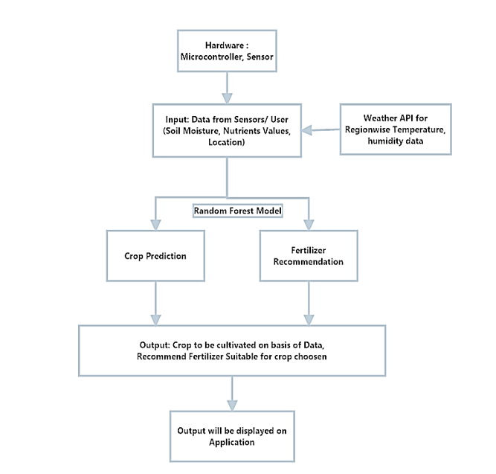
System Design

Slide 10
Timeline of Project
TASK | SEPTEMBER (week 1-4) | OCTOBER (week 5-8) | NOVEMBER (week 9-12) | DECEMBER (Week 13-16)
Project Planning & Requirement Gathering
Data Collection & Preprocessing, Algorithm Development
UI Development
Integration & Testing, Deployment & Feedback

Slide 11
Results Obtained
1. High Prediction Accuracy with Machine Learning
The application of Random Forest Regression in predicting fertilizer requirements has demonstrated remarkable accuracy. For instance, a study focusing on crop yield predictions in Rajasthan's 3A agroclimatic zone achieved an accuracy of 92.3% using this method. This high precision is due to the model's capability to analyze multiple factors, including soil quality, weather conditions, and crop types, enabling effective fertilizer management strategies.
2. Enhanced Fertilizer Efficiency and Crop Yields
Precision agriculture technologies dynamically adjust fertilizer recommendations based on real-time environmental data, leading to improved fertilizer efficiency and increased crop yields. The USDA Agricultural Research Service notes that such technologies can enhance environmental sustainability by reducing the over-application of fertilizers, seeds, and herbicides.
3. User-Friendly Web Interface
Developing intuitive web interfaces is crucial for the adoption of precision agriculture technologies, especially among farmers with limited technical expertise. The U.S. Government Accountability Office (GAO) highlights that the complexity of these technologies can pose adoption challenges, emphasizing the need for user-friendly designs to facilitate straightforward data entry and deliver clear, actionable recommendations.

Slide 12
Results Obtained(Continued)
4. Scalability and Accessibility via Cloud Platforms
Hosting agricultural systems on cloud platforms ensures scalability and accessibility, allowing for the seamless processing of large datasets and providing instant recommendations, even in remote areas with limited bandwidth. The Nature Conservancy underscores the importance of scalable solutions, noting that precision agriculture can reduce water and fertilizer use by 20-40%, thereby promoting sustainable practices.
5. Positive Environmental Impact
The adoption of precision agriculture systems contributes to environmental sustainability by minimizing fertilizer overuse, which in turn reduces runoff into water bodies and promotes soil health. The USDA Agricultural Research Service indicates that these technologies can potentially improve environmental sustainability by reducing the over-application of fertilizers, seeds, and herbicides.
6. Challenges and Opportunities
Despite the benefits, challenges such as high upfront acquisition costs, lack of uniform standards, and data sharing concerns can hinder the broader adoption of precision agriculture technologies. The GAO identifies these issues and suggests that addressing them presents opportunities for future improvements, including developing policies to mitigate these challenges and enhance farmer engagement.

Slide 13
Conclusion
The Precision Fertilizer Management project embodies a significant step towards transforming agricultural practices through the use of technology. By harnessing the power of machine learning, this initiative provides farmers with tailored fertilizer recommendations, enabling them to make informed decisions that enhance crop yields while protecting the environment. The integration of real-time and historical data allows for a more responsive approach to nutrient management, ultimately leading to sustainable farming practices. As we strive to bridge the gap between advanced agricultural technology and the everyday needs of farmers, this project holds the potential to not only improve agricultural productivity but also foster a healthier ecosystem for future generations. Together, we can pave the way for a greener, more sustainable future in agriculture.

Slide 14
References
Hampannavar, K., Bhajantri, V., & Totad, S. G. (2018)
Prediction of crop fertilizer consumption. International Conference on Computational and Business Intelligence (ICCUBEA). https://doi.org/10.1109/ICCUBEA.2018.8697827.
2. Prabakaran, G., Vaithiyanathan, D., & Ganesan, M. (2018)
Fuzzy decision support system for improving the crop productivity and efficient use of fertilizers. Computers and Electronics in Agriculture, 145, 205-211. https://doi.org/10.1016/j.compag.2018.01.011.
3. Yin, Y., Ying, H., Zheng, H., Zhang, Q., Xue, Y., & Cul, Z. (2019)
Estimation of NPK requirements for rice production in diverse Chinese environments under optimal fertilization rates. Agricultural and Forest Meteorology, 263, 146-158. https://doi.org/10.1016/j.agrformet.2018.08.003
4. Hess, L. J. T., Hinckley, E. L. S., Robertson, G. P., & Matson, P. A. (2020)
Rainfall intensification increases nitrate leaching from tilled but not no-till cropping systems in the US Midwest. Agriculture, Ecosystems & Environment, 293, 106841. https://doi.org/10.1016/j.agee.2020.106841
5. Nishant, P. S., Venkat, P. S., Bollu, L., & Jabber, B. A. (2020)
Crop yield prediction based on Indian agriculture using machine learning. 2020 International Conference for Emerging Technology (INCET). https://doi.org/10.1109/INCET49848.2020.9154125

Slide 15
References(Contined)
6. Yang, T., Siddique, K. H. M., & Liu, K. (2020)
Cropping systems in agriculture and their impact on soil health. Global Ecology and Conservation, 24, e01230. https://doi.org/10.1016/j.gecco.2020.e01230
7. Agrahari, R. K., Kobayashi, Y., Tanaka, T. S., Panda, S. K., & Koyama, H. (2021)
Smart fertilizer management. Taylor & Francis.
8. Ather, D., Madan, S., Nayak, M., Tripathi, R., Singh, S., & Jain, K. R. (2022)
Selection of smart manure composition for smart farming using artificial intelligence technique. Wiley Online Library.
9. Swaminathan, B., Palani, S., Subramaniyaswamy, S., & Vairavasundaram, S. (2023)
Deep neural collaborative filtering model for fertilizer prediction. Elsevier. https://doi.org/10.1016/j.future.2022.01.027
10. Gao, Y., Dong, K., & Yue, Y. (2024)
Projecting global fertilizer consumption under shared socioeconomic pathway (SSP). Elsevier. https://doi.org/10.1016/j.agsy.2023.103613

Slide 16

Project work mapping with SDG
SDG 2 (Zero Hunger): By improving crop yield through optimized fertilizer use, the project helps ensure food security.
SDG 12 (Responsible Consumption and Production): The project promotes efficient use of resources, reducing the environmental footprint of fertilizers and promoting sustainable agricultural practices.
SDG 13 (Climate Action): By minimizing fertilizer runoff and optimizing use, the project contributes to reducing agriculture’s impact on climate change.

Slide 17
Publication Details
Title: Precision Fertilizer Management
Authors: P Sai Teja, Vishnu Priya S, Vaishnavi A L, Sujan T
Sr. No: IJRPR 123849-1
Published At: International Journal of Research Publications and Reviews
Date of Publications: 15-01-2025

Slide 18
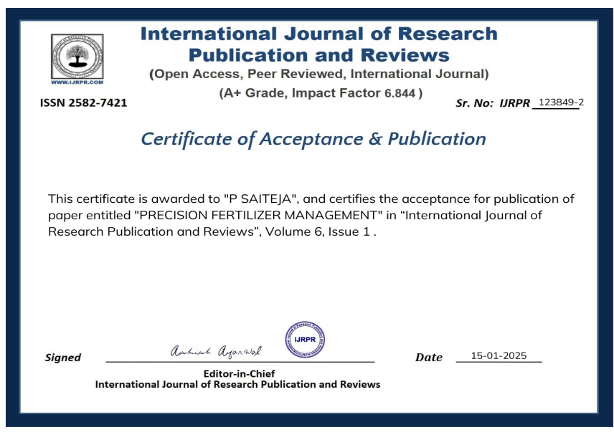
Achievements - (Published research paper)

Slide 19
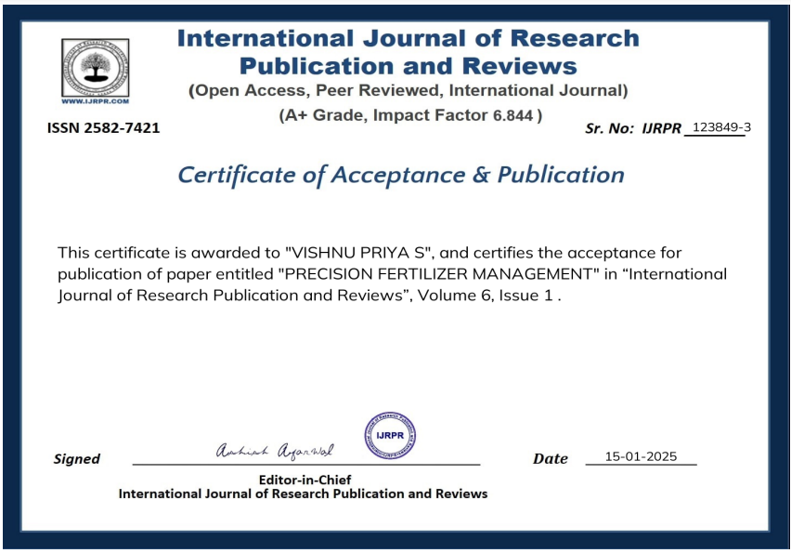

Slide 20
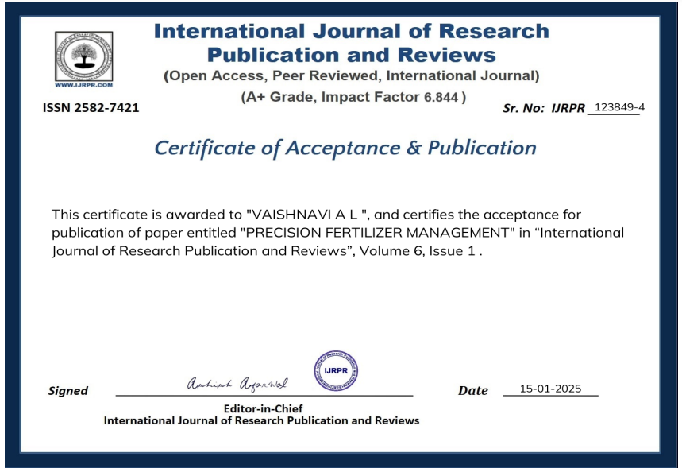

Slide 21
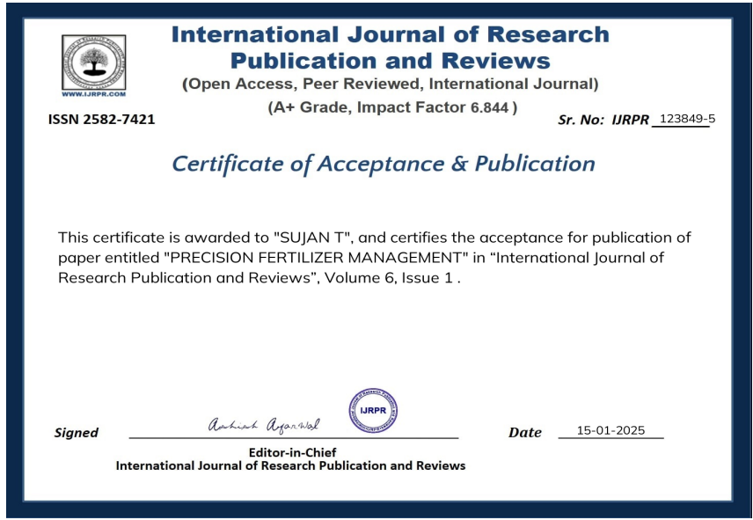

Slide 22

Thank You

